Slide 1

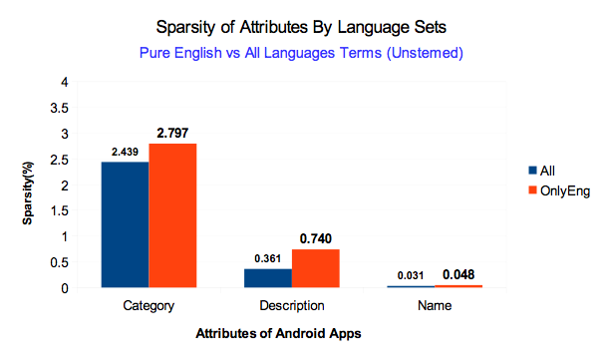
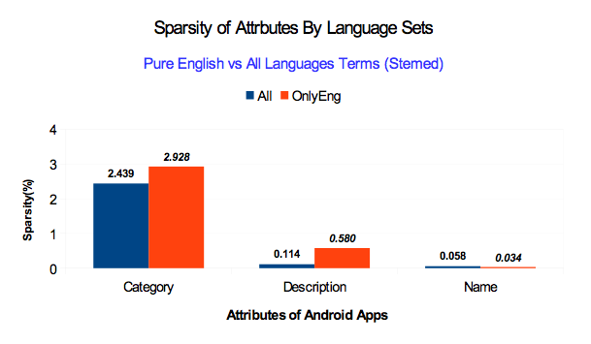
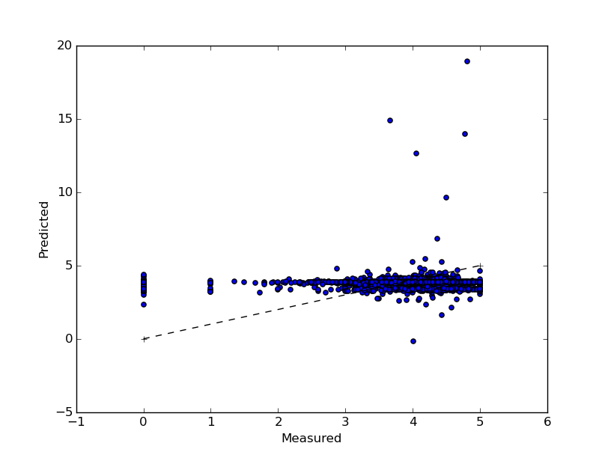
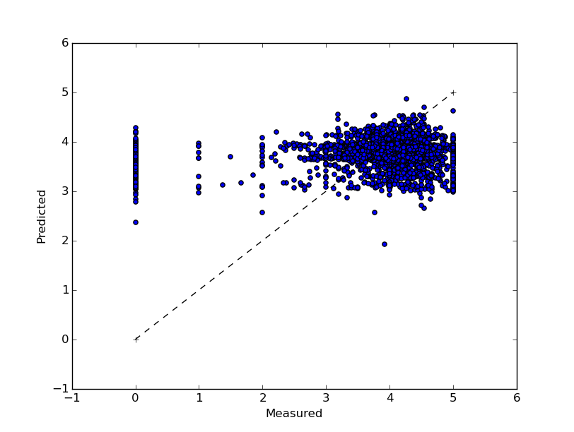

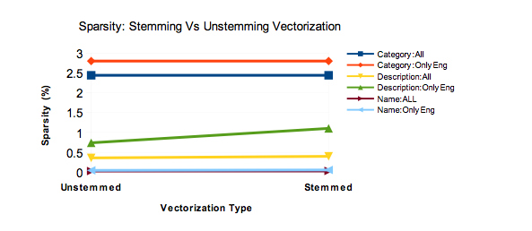
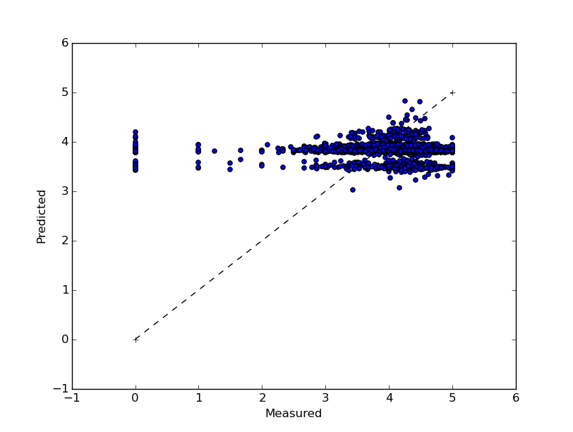
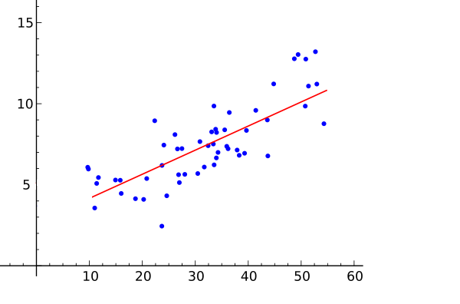
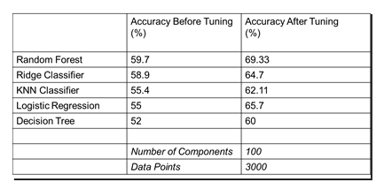
BigData
Predicting PlayStore Rating for Apps
Overview
Work
More Work
What is the project
Document Vectorization
Linear Regression 2
The project is a software that uses BigData and Data Science techniques to predict “Google PlayStore” ratings for new applications using patterns found in a file that contains all ratings data from applications that are already available in the “Google Playstore”.
With all features
Without high dimensional features
10 fold cross validation | iter1 | iter2 | iter3 | iter4
Residual sum of squares | 1.27 | 1.38 | 1.36 | 1.10
Variance score | 0.07 | 0.13 | 0.04 | 0.01
4 fold cross validation | iter1 | iter2 | iter3 | iter4
Residual sum of squares | 1.36 | 1.33 | 1.18 | 1.20
Variance score | 0.49 | 0.38 | 0.19 | 0.25
Without vectorized features
Data
The attributes Category, Developer, Name, ContentRating, and Description, were transformed into numerical information.
Classification
Classification is used to identify the category of a new observation on the basis of training data whose categories are know.
Selected classifiers with higher accuracies.
Implemented Grid Search technique to get set of optimal parameters.
Data transformation
Linear Regression
The data of this project has been collected from the author of the GitHub repository GooglePlayAppsCrawler.
GitHub link: https://github.com/MarcelloLins/GooglePlayAppsCrawler.git
Attributes used : AppSize, Price, IsTopDeveloper, HaveInAppPurchase, isFree, PublicationDate, LastUpdateDate, Installations, Category, Developer, Name, ContentRating, and Description.
Some of the attributes needed vectorization while others were numerical or could be transformed.
The attributes that needed vectorization are: Name, Description. Category, Content Rating, Developer.
A simple regression model for supervised learning was used to predict a target variable Y which is linearly dependent on other independent variable(s) X
Used cross validated prediction to visualize prediction errors.
K-fold cross validation (k=4) technique was applied to randomize the train and test dataset.
Principal Component Analysis was done to reduce the number of features to around 100.
Members
Faculty
Students
Dr. Somya Mohanty
Ayush Raj Aryval
Lucas Ribeiro
Naila Bushra
Naresh Adhikari
Expetenda reprimique id eos, ius eius

